Slide 1
IST718 Calculus Review
Willard Williamson
Adjunct Professor
iSchool, Syracuse University
linkedin.com/in/ncc-1701-d

Slide 2
Credits
Thanks to Berkeley University: https://math.berkeley.edu/~xuwenzhu/classes/18.089/summer2015/Lecture/Lecture1.pptx
Thanks to UCLA University: http://www.math.ucla.edu/~tat/MicroTeach/deriv.ppt

Slide 3
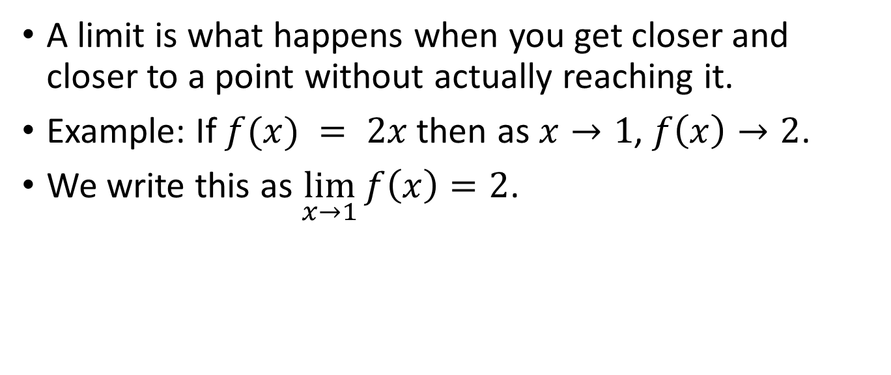
What is a limit?
A limit is what happens when you get closer and closer to a point without actually reaching it.
Example: If $f(x) = 2x$then as $x→1$, $f\left(x\right)→2$.
We write this as $\lim_{x→1}{f\left(x\right)=2}$.
x | 0 | .9 | .99 | .999 | .9999
f(x) | 0 | 1.8 | 1.98 | 1.998 | 1.9998

Slide 4
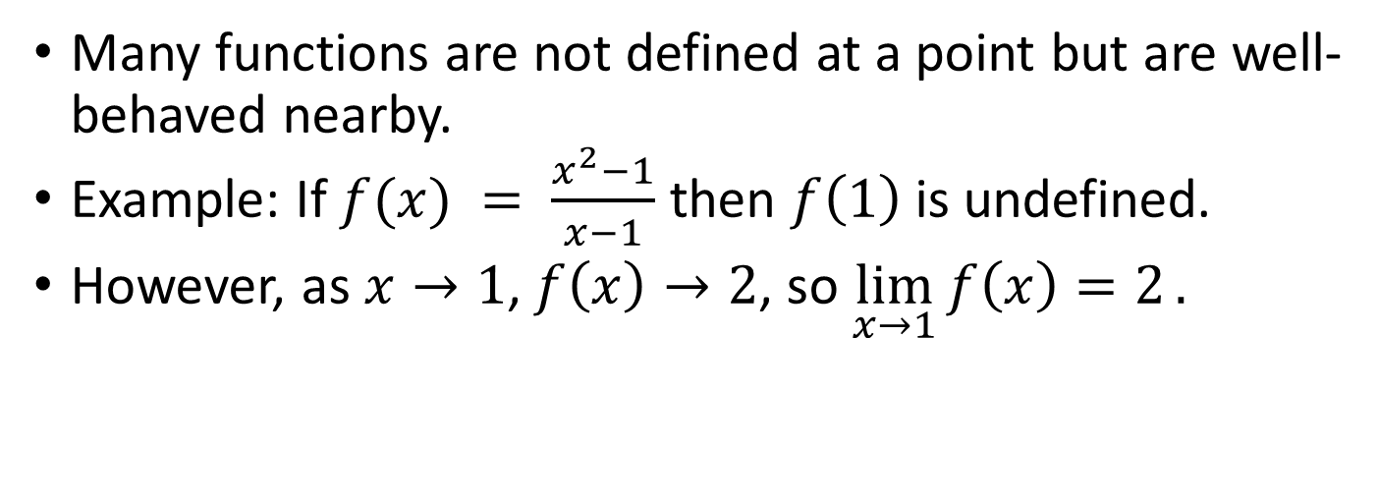
Why are limits useful?
Many functions are not defined at a point but are well-behaved nearby.
Example: If $f(x) = \frac{x^{2}−1}{x−1}$ then $f\left(1\right)$is undefined.
However, as $x→1$, $f\left(x\right)→2$, so $\lim_{x→1}{f\left(x\right)=2}.$
4
3
2
x | 0 | .9 | .99 | .999 | .9999
f(x) | 0 | 1.9 | 1.99 | 1.999 | 1.9999
1
f(x)
0
-1
-2
-3
-4
-4
-3
-2
-1
0
1
2
3
4
x

Slide 5
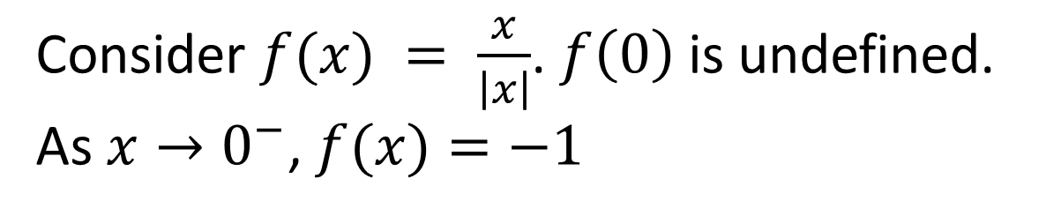
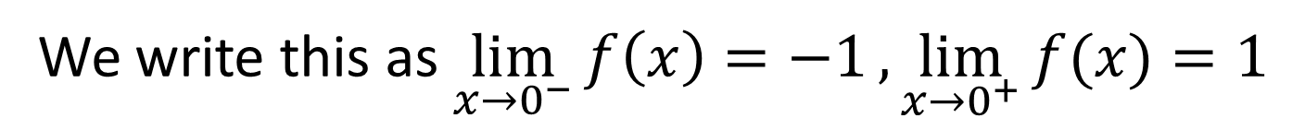
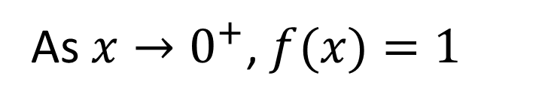
Left Limits and Right Limits
Consider $f(x) = \frac{x}{\left|x\right|}$. $f\left(0\right)$is undefined. As $x→0^{−}$, $f(x)=−1$
4
x | -1 | -.1 | -.01 | -.001 | -.0001
f(x) | -1 | -1 | -1 | -1 | -1
3
2
1
As $x→0^{+}$, $f(x)=1$
f(x)
0
-1
x | 1 | .1 | .01 | .001 | .0001
f(x) | 1 | 1 | 1 | 1 | 1
-2
-3
-4
-4
-3
-2
-1
0
1
2
3
4
x
We write this as $\lim_{x→0^{−}}{f\left(x\right)=−1},\lim_{x→0^{+}}{f(x)}{=1}$

Slide 6
What is a derivative?
Given a function
A derivative is the rate of change of that function
Can be represented by slope of the line tangent to the curve

Slide 7
The tangent line
single point
of intersection

Slide 8
slope of a secant line
A secant line connects 2 points on a curve together
f(a) - f(x)
a - x
f(x)
f(a)
x
a

Slide 9
slope of a (closer) secant line
f(a) - f(x)
a - x
f(x)
f(a)
x
x
a

Slide 10
closer and closer…
a

Slide 11
watch the slope...

Slide 12
watch what x does...
x
a

Slide 13
The slope of the secant line gets closer and closer to the slope of the tangent line...

Slide 14
As the values of x get closer and closer to a!
x
a

Slide 15
The slope of the secant lines
gets closer
to the slope of the tangent line...
...as the values of x
get closer to a
Translates to….

Slide 16
f(x) - f(a)
lim
x - a
x
a
as x goes to a
Equation for the slope
Which gives us the the exact slope
of the line tangent to the curve at a!

Slide 17
thus...
lim f(a+h) - f(a)
h 0
h
AND
lim f(x) - f(a)
x a
x - a
Give us a way to calculate the slope of the line tangent at a!

Slide 18
similarly...
f(x+h) - f(x)
(x+h) - x
= f(x+h) - f(x)
h
f(a+h)
h
f(a)
a+h
a
(For this particular curve, h is a negative value)

Slide 19
Which one should I use?
(doesn’t really matter)

Slide 20
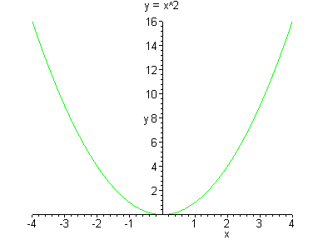
A VERY simple example...
want the slope
where a=2

Slide 21
as x a=2

Slide 22
As h 0, x -> 2 in this example

Slide 23
back to our example...
When a=2,
the slope is 4

Slide 24
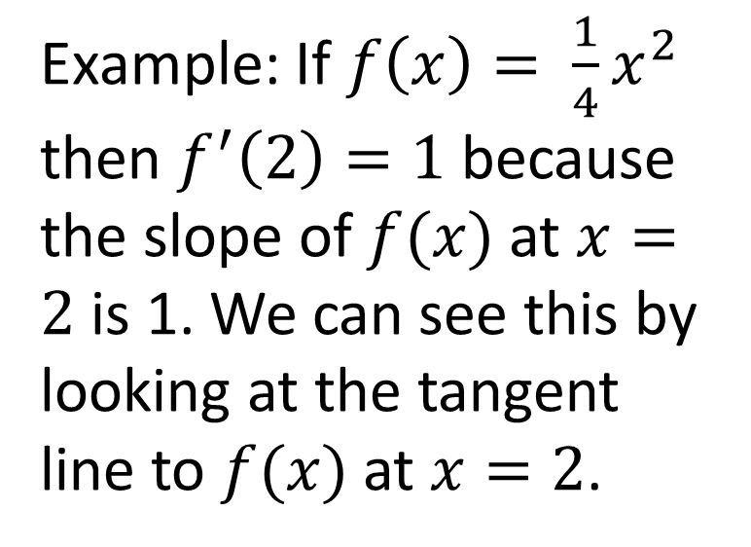
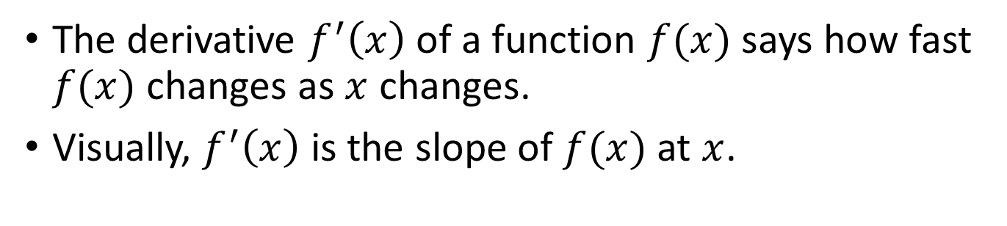
What is a derivative?
The derivative $f^{′}\left(x\right)$ of a function $f(x)$ says how fast $f(x)$ changes as $x$ changes.
Visually, $f^{′}\left(x\right)$ is the slope of $f(x)$ at $x$.
4
Example: If $f\left(x\right)= \frac{1}{4}x^{2}$ then $f^{′}\left(2\right)=1$ because the slope of $f(x)$at $x=2$ is 1. We can see this by looking at the tangent line to $f(x)$at $x=2$.
3
2
1
f(x)
0
-1
-2
-3
-4
-4
-3
-2
-1
0
1
2
3
4
x

Slide 25
Why are derivatives useful?
Tells us how quickly something is changing.
In physics: velocity is the derivative of position and acceleration is the derivative of velocity (with respect to time).
Optimization: Derivatives are crucial for finding the minimum or maximum of functions.
And much much more.

Slide 26
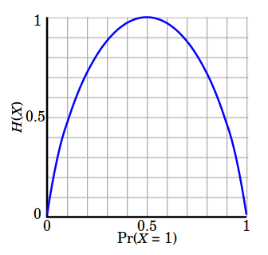
How to Find the Maximum?

Slide 27
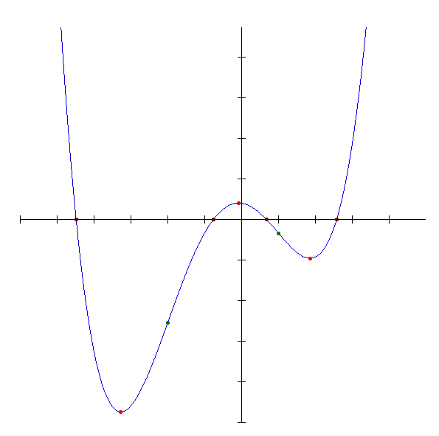
How To Find the Minimum?

Slide 28
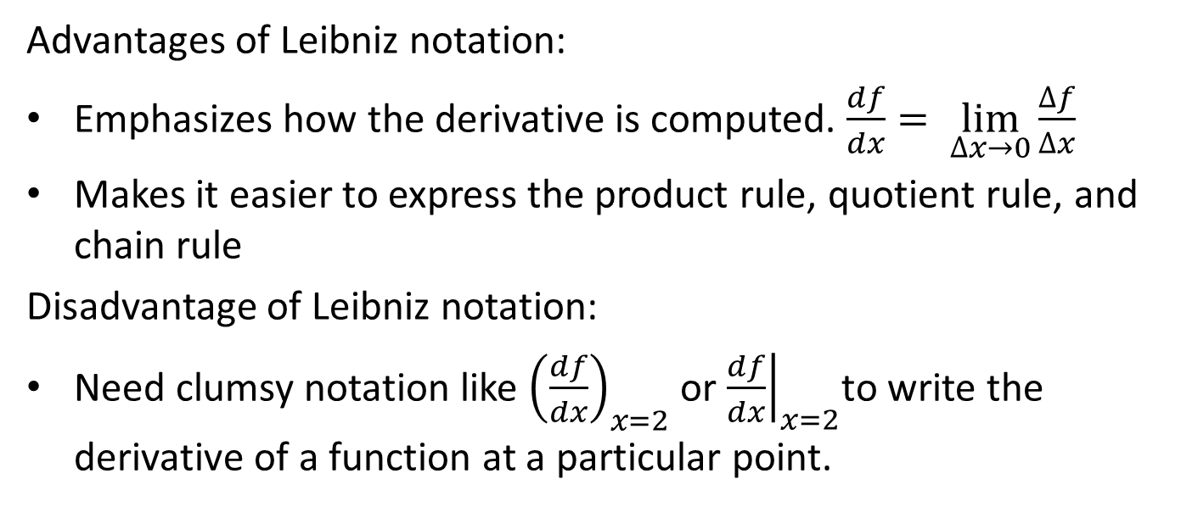
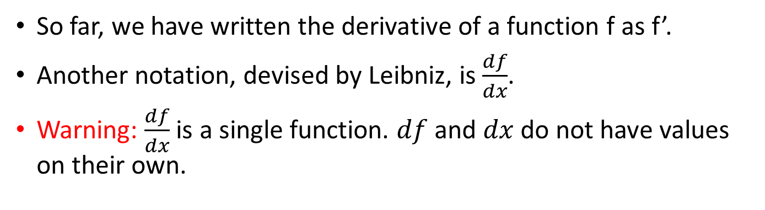
Leibniz Notation
So far, we have written the derivative of a function f as f’.
Another notation, devised by Leibniz, is $\frac{df}{dx}$.
Warning: $\frac{df}{dx}$ is a single function. $df$ and $dx$ do not have values on their own.
Advantages of Leibniz notation:
Emphasizes how the derivative is computed. $\frac{df}{dx}= \lim_{∆x→0}{\frac{∆f}{∆x}}$
Makes it easier to express the product rule, quotient rule, and chain rule
Disadvantage of Leibniz notation:
Need clumsy notation like ${\left(\frac{df}{dx}\right)}_{x=2}$ or ${\left.\frac{df}{dx}\right|}_{x=2}$to write the derivative of a function at a particular point.

Slide 29
in conclusion...
The derivative is the the slope of the line tangent to the curve (evaluated at a point)
it is a limit (2 ways to define it)
once you learn the rules of derivatives, you WILL forget these limit definitions (beyond the scope of IST-718)
cool site to go to for additional explanations:http://archives.math.utk.edu/visual.calculus/2/

